Slide 1

Welcome to the IMD Movie Data Analyst Project
Project by- Chetan

Slide 2

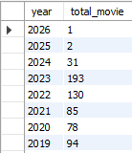
Q1 Count of Movies by Year
Query:-
Output:-
Conclusion
This query shows the number of movies released each year, helping identify trends in movie production. It highlights peak years, industry growth, and potential declines due to external factors. Sorting by descending order makes recent trends more visible. 🚀

Slide 3
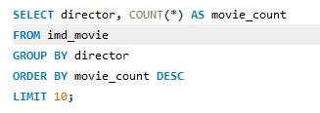
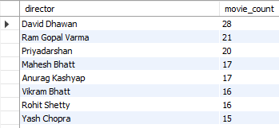
Q2 Top 10 Directors with Most Movies
Query:-
Output:-
Conclusion
This query lists the top 10 directors with the highest number of movies in the dataset. It highlights the most prolific filmmakers, showing their impact on the industry. The results help in analyzing director popularity, career longevity, and contribution to cinema. 🚀

Slide 4
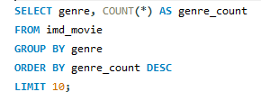
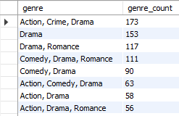
Q3 Most Common Movie Genres
Query:-
Output:-
Conclusion
This query identifies the top 10 most common movie genres based on their frequency in the dataset. It helps analyze audience preferences, industry trends, and the dominance of certain genres over time. The results can be used for market research, content strategy, and understanding shifts in filmmaking trends. 🚀

Slide 5
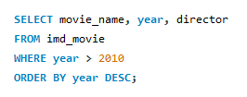
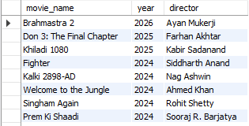
Q4 Movies Released After 2010
Query:-
Output:-
Conclusion
This query retrieves movies released after 2010, sorted in descending order by year. It helps analyze modern filmmaking trends, identify recent popular directors, and observe changes in genre preferences over time. 🚀

Slide 6
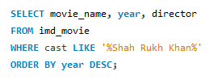
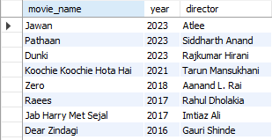
Q5 Find Movies Featuring a Specific Actor (e.g., "Shah Rukh Khan")
Query:-
Output:-
Conclusion
This query retrieves all movies featuring a specific actor (e.g., Shah Rukh Khan), sorted by the most recent releases. It helps analyze the actor's filmography, career trends, and collaborations with different directors over time. 🚀

Slide 7
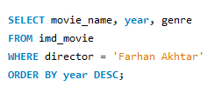
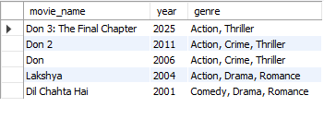
Q6 Find Movies by a Specific Director (e.g., “Farhan Akhtar")
Query:-
Output:-
Conclusion
This query retrieves all movies directed by a specific director (e.g, Farhan Akhtar), sorted by the most recent releases. It helps analyze the director's filmography, genre preferences, and career progression over time. 🚀

Slide 8
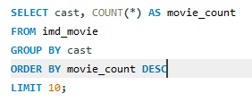
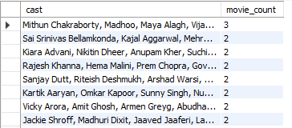
Q7 Count of Movies per Actor (if cast is stored as a comma-separated string)
Query:-
Output:-
Conclusion
This query identifies the top 10 actors with the most movies in the dataset. It helps analyze the most frequently appearing actors, their dominance in the industry, and their career longevity. However, if the cast column contains multiple actors in a single entry, data cleaning or normalization is required for accurate results. 🚀

Slide 9
Thank You

